Slide 1
CS411 Project Overviews
Khuram Shahzad
Jiayi "Joey" Cao
02-01-2017

Slide 2
Upcoming Lectures
Track 1 and Track 2 Project Overviews (02/01)
Tutorial 1: Track 1 and Web Programming (02/06)
Recommendation: bring your laptops
Tutorial 2: cPanel, SQL and HTML programming (02/15)
Recommendation: bring your laptops

Slide 3
CS 411 Projects
Database Projects
Required for all
Design and implement a web-based database management system (or a mobile application)
Survey
- Only for 4-credit students
Need to conduct a survey on a specific research topic related to data management system
Need to submit a survey (8-10 pages) along with a presentation (~10 slides)

Slide 4

Every student taking cs411 does project 1 (DB application)

Slide 5
Goals for Project 1
Apply theoretical concepts during the design of a real data-driven web/mobile application
Learn how to collaborate in teams and meet deadlines
Train the creativity “muscles” and be bold embarking on adventurous projects
Build your portfolio for getting a job/internship

Slide 6
There are 5 major stages:
There are 5 major stages
Stage 0: Group Formation: Feb 6, 2017 (very soon!!!)
Stage 1: Functional Description and ER Design (Feb 20)
Stage 2: Development Plan (Feb 27)
Stage 3: Setup Development Environment (March 01)
Stage 4: Initial Demo + Advanced SQL Queries (March 13-15, Before spring break)
Stage 5: Final Demo and Report (April 17-19)

Slide 7
There are 5 major stages:
Stage 0: Group formation
Groups must have 3-4 people (no teams of 1, 2, 5 or more)
Undergraduates could team up with graduates
Offline can team up with online students
Suggestions:
Have someone experienced in a team
Have someone from a different department
Have someone in engineering/design/product
Pick a “captain” to manage the team

Slide 8
There are 5 major stages:
Stage 1: Functional Description & Entity-Relationship Design
Requirements:
Pitch/short description (Every group is required to meet us during our office hours)
Usefulness and existing analogs
Is it really useful to our society?
Realness
How do you plan to get data? Users?
Features
Basic functionality
Advanced functionality
ER diagram- with all necessary assumptions

Slide 9
There are 5 major stages:
Advanced features for the project
Should be relevant and useful for your application
No primary analogs accessible just via API
Should be technically challenging (machine learning, data viz with serious preprocessing, real-time)
at least 3-4 days of work for the whole team per advanced function to implement excluding learning how to code
build upon external libraries not just use them as-is
You should be able to clearly explain the technical challenge in each advanced function

Slide 10
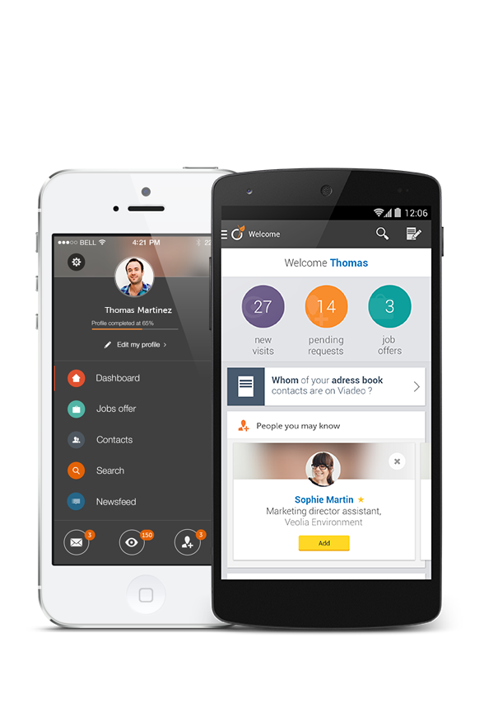
There are 5 major stages:
We will build iOS and Android mobile apps…

Slide 11

A mobile app itself doesn’t count
There are 5 major stages:

Slide 12
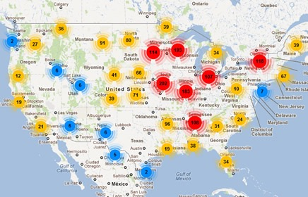
There are 5 major stages:
We will have a cool map with interactive clickable elements…

Slide 13
There are 5 major stages:
Using Google API doesn’t count

Slide 14
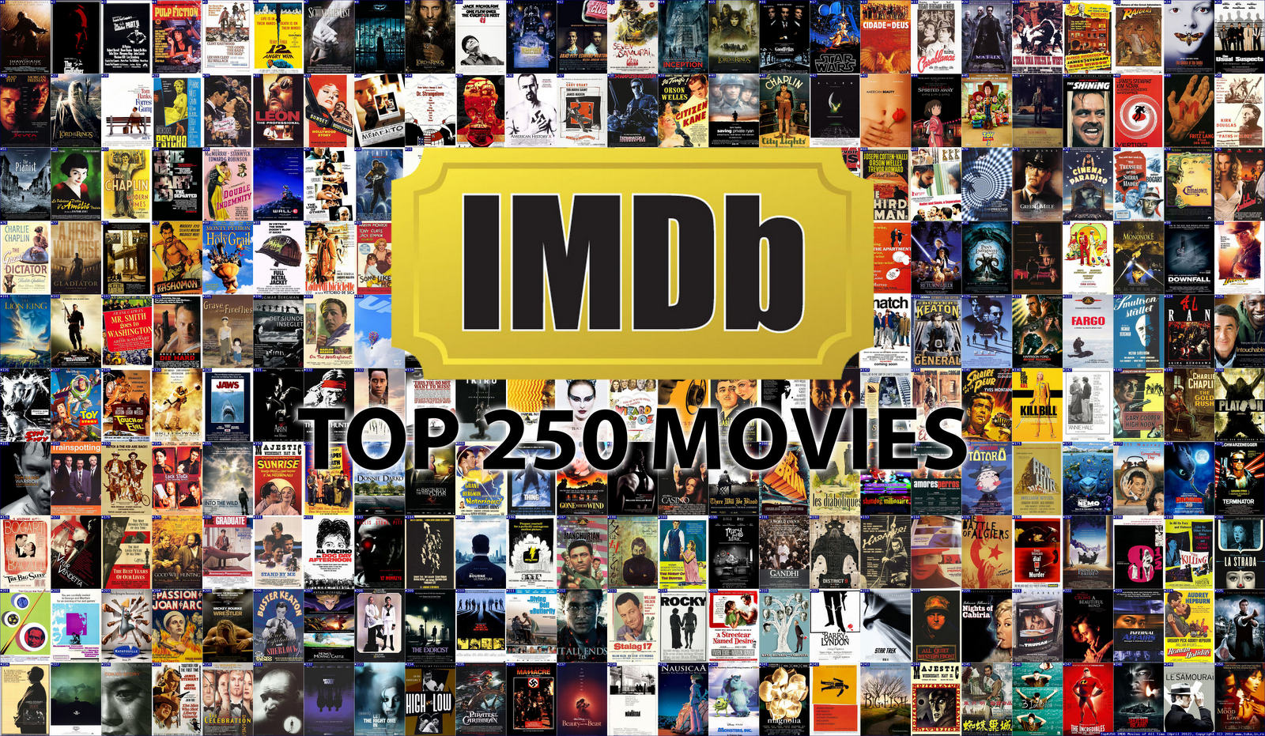
We will extract data from IMDB…
There are 5 major stages:

Slide 15
We will extract data from IMDB…
There are 5 major stages:

Slide 16

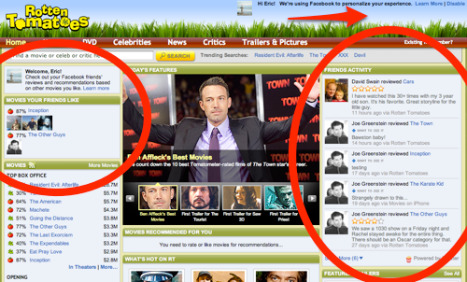
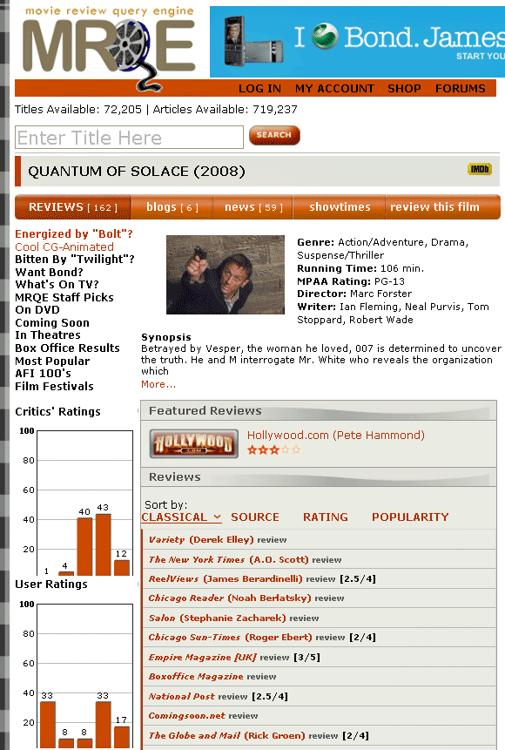
We will extract data from 100 movie websites automatically…
There are 5 major stages:

Slide 17

We will extract data from 100 movie websites automatically…
There are 5 major stages:

Slide 18
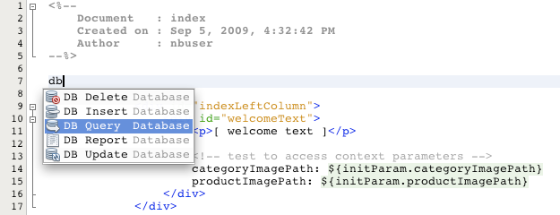
We will do SQL query suggestion based on DB schema…
There are 5 major stages:

Slide 19
We will do SQL query suggestion based on DB schema…
There are 5 major stages:

Slide 20
There are 5 major stages:
Rules of thumb to help you judge whether it qualifies for AF
A good data-driven company released a similar feature a few years ago
You can make a startup out of it because building such a thing is hard
There is a research paper at a top conference talking about it but no one in the industry built it yet – you can take make a demo illustrating a research idea (can write a paper about it)
Discuss with your TAs ;)

Slide 21
There are 5 major stages:
Stage 2: Development Plan
The relational schema of your database
Final choices of databases and software platforms/languages that you will be using
How you will get data for your application (crawling the Web/API/crowdsourcing…)
Division of responsibilities of team members
The project timeline with milestones

Slide 22
There are 5 major stages:
Stage 3: Setup Development Environment
Play with cPanel, MySQL, HTML
Initiate a site and add your project URL to Wiki
the site could be empty but the URL must be working (just put there name of team members for now)
If you are building a mobile app, assemble a project package and share it via a quick release (link to the app download and early access)

Slide 23
There are 5 major stages:
Stage 4: Midterm Demo (10 min)
Data enough to showcase CRUD functionality
Working basic functionality
Create/Insert records to the DB
Read/Search records in the DB
Update records in the DB
Delete records from the DB
Advanced SQL queries(subquery, having, case, union, etc)
Remember:- This shouldn’t be your login information
Describe your advanced functions and clearly articulate why they are advanced

Slide 24
There are 5 major stages:
Stage 5: Final Demo (15-20 min)
Final Demo including
Real data in the system (crawled from the Web, using API, or from user’s generated data having at least 25 + records)
Record a project demo video
Repeat CRUD/basic functionality
Join queries
Present your advanced functions and clearly articulate why they are advanced
Project Final Report

Slide 25
There are 5 major stages:
DB Project 1 Grading
[4%] Stage 1: Functional Description
[3%] Stage 2: Development Plan
[3%] Stage 3: Setup Development Environment
[30%] Stage 4: Initial Demo [25%] + 2 SQL queries [5%]
[60%] Stage 5: Final Demo + Report + Video
[40%] Final Demo
[10%] Basic features and joins
[30%] Advanced features
[15%] Final Report
[5%] Demo video (2-3 min video on Youtube)

Slide 26
Top Selected Projects
5% Bonus points
At the end of the semester, TAs(and peers) will choose 4 teams as excellent projects
To be selected, the projects need to have either innovative algorithms, unique user interface or something extraordinary.

Slide 27
There are 5 major stages:
How to pick a good project idea?
Are we solving a real problem?
Is this problem important? How often people face such a problem?
Will there be users for the application? How many? Why should they use the application?
Are there any similar projects/websites? How the solution will be better than existing ones?
Is it real to implement in a limited time frame we have?

Slide 28
There are 5 major stages:
Popular student project ideas in the past [add something new!]
Academic:
Course material search, project partner search , …
Entertainment:
Book recommendation, music/playlist sharing, fantasy football analysis, dating, cooking,….
Productivity systems:
Task management, human resource management, …
Healthcare:
Physician recommendation

Slide 29
There are 5 major stages:
Easy strategy to pick projects
Pick a startup or your favorite company and re-implement their functionality with some new twists.
A tiny Amazon: managing and selling inventories of book
A tiny Uber: match uber drivers to users to get a ride
A tiny Airbnb: an app to match home-owners to visitors
A tiny Facebook: a mini version of facebook where users can track all their friends likes, posts or comments

Slide 30

CS 411: HALL OF FAME
Acknowledgements go to the students who took CS 411 in 2012, 2013, 2014, 2015
http://www.youtube.com/watch?v=KHbruxjcmOs&feature=youtu.be
https://www.youtube.com/watch?v=Z_C1oJEWfCc&feature=youtu.be
https://www.youtube.com/watch?v=bbviIkn0i-E&feature=youtu.be
https://www.youtube.com/watch?v=nN_2iYW421E&feature=youtu.be

Slide 31
4-credit students do both project 1 (DB application) and project 2 (survey on one cutting edge DB research topics)

Slide 32
Goals for Project 2 (DB survey)
Expert knowledge of the state-of-the-art
Don’t reinvent the wheel
Really understand the connections between methods
Build a special angle on a topic and identify prospective research problems
Improve your knowledge on critical thinking skills and analytical work with a lot of scientific literature

Slide 33
Select the right topic
Read 5-10 surveys from ACM Computing Surveys to get the idea of material organization
What are the typical sections?
How long it should be?
How to present ideas?
Select a few interesting topics and:
Search for existing surveys and assess their quality
Estimate the amount of papers published
Is topic trendy, popular, important, impactful?
Pick the one that you will write about!
Notes:
Remember you want to prepare a work, which will be really useful and goes beyond the scope of the class.
After reading other surveys from SIGKDD and ACM Surveys you will get the idea what makes a survey a good survey.
Identify their survey perspective? Is it historical manuscript or survey of the state of the art.
If take too small will not have enough to write about, if to broad – you will get lost.
Pick a topic which is self contained yet, have enough things to survey about.

Slide 34
Have materials and a plan
1. Select the right topic
Find top researchers and research groups, conferences, journals, demo systems on selected topics
Skim through highly cited, recent articles of prominent researchers to get a good approximation of other good works
Write a plan with the answers to questions:
Why your survey will be important? What’s new? What perspective you want to open?
Set deadlines for yourself and follow them
Add key citations at the end of the proposal
Notes:
You will follow them to get papers
State-of –the—art, historical, practical, efficiency, scalability, multidisciplinary

Slide 35
3. Make a comprehensive list of papers
Topics to work on
1. Select the right topic
Main-memory database systems
Interactive visualization systems
Columnar databases
Auto-tuning of database systems
Approximate query processing
Stream processing systems
Graph database systems
Semi-structured database systems
OLAP Systems
Multi-query optimization
Parallel query optimization

Slide 36
3. Make a comprehensive list of papers
Make a comprehensive list of papers
1. Select the right topic
(NOT REQUIRED)
Build a Table
Title
Subtopic (will be a section of a paper)
Key ideas
Conference
Quality
Year
Authors
Other Information

Slide 37
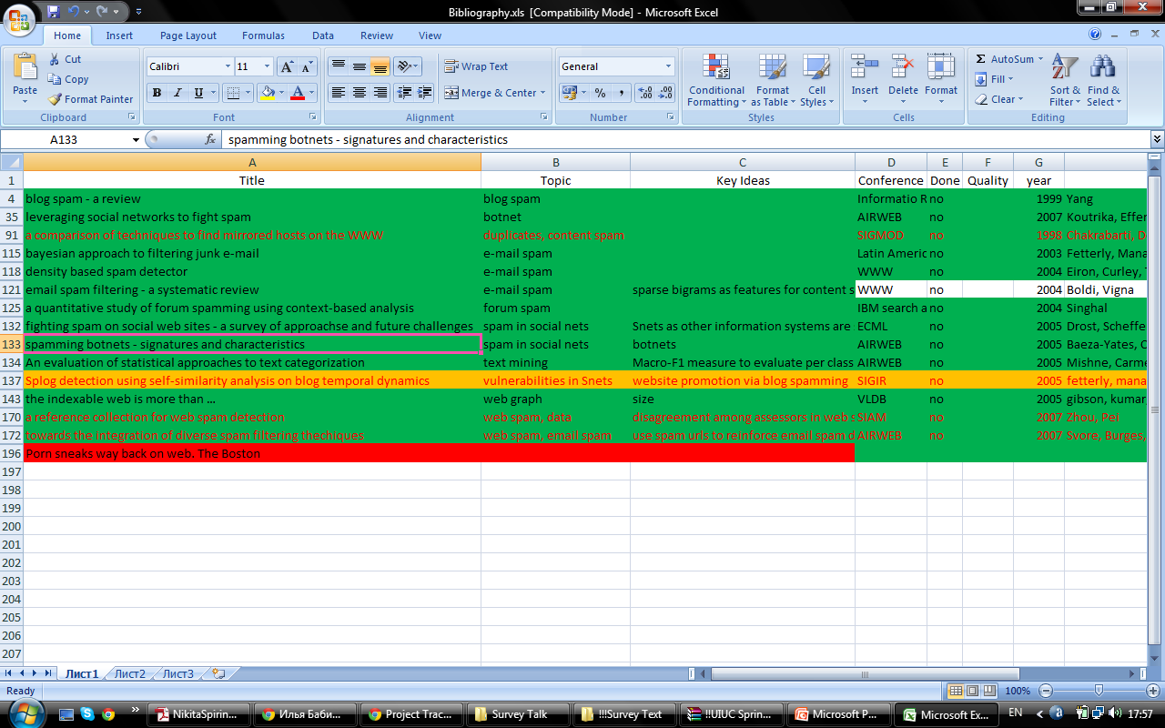
Make a comprehensive list of papers
Notes:
Use color to mark progress
Green done
Yellow read not write
Red not started, don’t know what’s there

Slide 38
Suggestions on how to take notes while reading
3. Make a comprehensive list of papers
1. Select the right topic
(NOT REQUIRED)
While reading papers create a citation graph traversal policy (BFS, DFS)
Read a text, update record in your table
Write about it in the text, right after your read it
Add references to the .bib file
Having finished a block of papers, revise the big picture and see how ideas fit together
Notes:
BFS good paper – other good papers
DFS good researcher – other works
Otherwise, you will forget about it – too many papers
I added them to the bib later, that was not good, now I know how to manage my citations in a paper
Use Zotero.

Slide 39
Typical timeline (part-time HQ survey)
3. Make a comprehensive list of papers
4. Taking notes and JIT writing, iterate
1. Select the right topic
1-2 weeks for paper selection, initial reading, and survey idea formalization
2-4 weeks writing an initial draft
2-4 weeks for the final editing before submission
Think Big! You really can submit it to the journal!

Slide 40
Have fun and good luck!
Project 1: https://wiki.illinois.edu/wiki/display/cs411sp17/Project+Track+1
Useful Resources:
https://wiki.illinois.edu/wiki/display/cs411sp17/Technical+Resources+for+Project+Track+1
Project 2: https://wiki.illinois.edu/wiki/display/cs411sp17/Project+Track+2

